Slide 1
Searching Pattern → Disk Free

Slide 2
Search pattren & Replace the String
Esc:/pattern – it will move to 1st occurrence then keep pressing n to 2nd and so on
Replace a string: General Syntax
Esc :%s/string1/string2/g
G is not mandatory, g means globally.
Esc :%s/linux/docs/g
s is substitute
Case:1
Esc: 1 s/string1/string2
Case:2
Esc:5 s/string1/string2/g

Slide 3
Replacing string
Case:3
Esc : ^,$ s/string1/string2/g
Case:4
Esc :1 s/linux/docs/g – changes in 1st line only
Esc :1,5 s/linux/docs/g –changes 1 to 5th line.
Esc :7,$ s/linux/docs/g – changes 7th to end of line.

Slide 4
Copy Command
Cp command
Is used to copy content of a file from one to another file
If destination file doen’t exists, it will create and copy it. if already exists then it will be overwritten to the content.
Cp src dest
Cp file1 file2
cp kp1.txt kp2.txt
Cp –r temp1 temp2 :whole temp1 content will be copied to temp2 recursively.
Mv command:
The source will get deleted and moved to destination. Or can be called as rename.
Mv src dest
mv kp1.txt kp2.txt

Slide 5
Delete
Delete the whole line Esc:dd
Echo
echo is a print statement.
Echo can be used in the scripting
Echo can be used in the linux commands.
Echo “ Hi How are you?”
Echo “welcome to the Class!”
Echo HELLO | cut –c3 output L
Echo HELLO | cut –c1,3 output HEL

Slide 6
Change Permission for file & Directory
Chmod command
Used to change permission of a file or directory
-r-- r-- r-- :- file or directory or link,
rwx=user, r--=group, r--=others R=read,w=write,x=execute
It will be in binary format r=4. w=2. x=1
Chmod 777 filename – all permission to a file
chmod 444 abc.txt
chmod 464 abc.txt
chmod 564 abc.txt
chmod 777 abc.txt
-rwxrwxrwx ------- abc.txt
Chmod u+w file –user and write permission to a file Group and other full permission
Chmod g+rwx,o+rwx file (+ Adding the permission)
Chmod g-w,o-w file (- Removing the permission)
Chmod a+rwx file

Slide 7
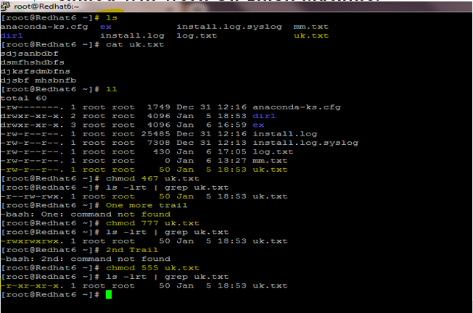
Chmod Will Work On Linux Machine.

Slide 8
Creating the user and groups
To add the new-user
Adduser sham
Passwd sham(username)
sham@123
To add the new-user
Adduser ramu
Passwd ramu
ramu@123
To create new group
Groupadd QA/Dev/DB
Creation of password is not required

Slide 9
Change Ownership of file or directory
Chown command
Change ownership of a file or dir
Change sham to ramu
Chown newowner filename
Example:Abc.txt owner: sham
New owner should be Ramu
Chown Ramu abc.txt
Chgrp command
Example: chgrp ibm file.txt

Slide 10
Shell, disk free , file counts
Shells
bash, , cshell, kshell
chsh: to change the shell use.
used to show current shell, echo $SHELL.
Wc command
Used to count number of lines, words, characters in a file
Wc –c, wc -w, wc -l
ex: wc –l filename
Du and df command
Du-disk usage or size of a file, df-disk free / size of drive Du –sh filename
Du –sh * Df –h . Df –h
Free –g : used to check the RAM size

